Slide 1
MSAI 699 CAPSTONE | WEEK 7
Explainable AI Email Triage
A research prototype evaluated for urgent-message prioritization Keith G. Broussard | Summer 2026
Notes:
Recording timing: 0:00-0:20
This project asks a practical question: can an explainable model help people notice potentially urgent email without pretending that software should make the final decision? I will show the evidence gathered, what that evidence establishes today, where reliability breaks down, and what should happen next.
[Sources]
- README.md
- docs/project_review_guide.md

Slide 2
Prioritize urgent email—keep the human in control
Operational need
Important messages can be buried in a high-volume inbox. A useful triage tool should surface likely urgent items and explain what influenced each score.
Risk boundary
False negatives can hide urgent work. False positives create review burden. The system remains decision support with human review—not an automatic routing authority.
INPUT
MODEL SUPPORT
HUMAN CONTROL
Incoming email
Score + explanation
Human decision
A message enters the local workflow for review.
The model ranks urgency and shows influential terms.
A person reviews the evidence and decides what action is appropriate.
2
Notes:
Recording timing: 0:20-1:01
The operational problem is straightforward. Important messages can be buried in a high-volume inbox, but urgency is not just a keyword. It can depend on deadlines, requests, relationships, and context. A useful triage tool should surface messages for attention and show why the model produced its score. The boundary matters just as much as the prediction. False negatives can hide urgent work, while false positives can overwhelm the reviewer. For that reason, this project treats the model as decision support. The system scores the message and provides an explanation, but a person remains responsible for the routing decision.
[Sources]
- README.md
- docs/decisions.md
- docs/week6_experiment_record.md

Slide 3
What the reviewer will see in the Week 8 demonstration
Visible evidence
An urgency score, both frozen threshold classifications, and bounded positive and negative feature contributions.
Guardrails
Synthetic or privacy-screened input. Human review required. Revise remains visible; no shadow or production approval.
INPUT
COMPARE
HUMAN CONTROL
Synthetic message
Score + thresholds
Reviewer decision
Privacy-screened content enters a local session.
The result shows 0.45 and 0.50 side by side.
A person interprets the evidence and chooses the action.
3
Notes:
Recording timing: 1:01-1:47
The planned Week 8 demonstration will make that boundary visible. A reviewer will enter a synthetic or privacy-screened message and receive an urgency score, classifications at the two frozen thresholds, and a short list of features that supported or opposed the score. Those contributions explain the fitted linear calculation; they are not causal explanations and they do not prove that a message is urgent. The same result will state that human review is required, the disposition is revise, and neither shadow testing nor production deployment is approved. The application is designed not to echo the submitted subject or body into its saved validation results. In practical terms, the interface will expose evidence for review without automating the decision.
[Sources]
- src/email_triage_demo/README.md
- src/email_triage_demo/model_service.py
- src/email_triage_demo/app.py
- docs/week7_automated_test_report.md

Slide 4
A small reviewed sample defines the evidence boundary
Evidence scope
Source records were filtered and manually reviewed before modeling.
517,401
199
30
Source records in the Kaggle Enron distribution.
Reviewed labeled messages used for this capstone evaluation.
Urgent messages; the remaining 169 were nonurgent.
4
Notes:
Recording timing: 1:47-2:29
The evidence begins with the Enron email corpus, which contains five hundred seventeen thousand, four hundred one source records. The capstone evaluation uses a much smaller reviewed sample of one hundred ninety-nine messages: thirty urgent and one hundred sixty-nine nonurgent. One hundred fifty-nine messages form the fixed training partition, and forty form a preliminary holdout. That sample supports a controlled academic evaluation, not broad claims about every inbox or production prevalence. The raw corpus and detailed review material stay outside the repository, while privacy-screened labels, metrics, notebooks, and decision records provide an auditable evidence trail.
[Sources]
- data/labels/enron_urgency_labels_v1.csv
- results/metrics/week6_reproducibility.json
- docs/week6_experiment_record.md

Slide 5
Selection and evaluation remained separate inside training data
TRAIN
INNER SELECTION
OUTER TEST
Establish
Fit TF–IDF and logistic regression on an outer-fold training subset.
Select
Choose the threshold inside inner folds without using outer-fold labels.
Evaluate
Score the held-out outer fold, combine predictions, then record the decision.
5
Notes:
Recording timing: 2:29-3:19
The project advanced through controlled checkpoints. First, the baseline established a reproducible T F I D F and logistic-regression reference. Next, model selection and explanation work used only the training partition. For Week 6, nested cross-validation separated selection from evaluation inside those one hundred fifty-nine training messages. Each outer fold acted as a temporary evaluation set, while the inner folds selected the threshold without seeing that outer fold's labels. The outer results were then combined for error analysis and the model decision. The preliminary holdout was examined only after the training-data decision was frozen, but earlier project work had already influenced it. It is therefore descriptive evidence, not a new untouched final test.
[Sources]
- notebooks/week6_testing_debugging.ipynb
- results/metrics/week6_outer_fold_metrics.csv
- results/metrics/week6_outer_predictions.csv
- docs/week6_experiment_record.md

Slide 6
Training gains did not establish reliable holdout performance
Training and holdout context
Training CV improved; the preliminary holdout repeated the 0.45/0.50 tradeoff.
+4.7 pts
2× recall
−29%
Mean cross-validated urgent F1 increased from 6.7% to 11.4%.
Mean cross-validated urgent recall increased from 4.0% to 8.0%.
TF–IDF features decreased from 4,097 to 2,895.
6
Notes:
Recording timing: 3:19-4:12
Optimization improved the training evidence, but the gains were modest. Mean cross-validated urgent F one increased from six point seven percent to eleven point four percent, urgent recall doubled from four percent to eight percent, and the selected T F I D F feature count decreased by twenty-nine percent. These results showed that the workflow could tune and reproduce a candidate. They did not establish a reliable classifier. At the frozen zero point four five threshold, the preliminary holdout identified all six urgent messages but also labeled all thirty-four nonurgent messages urgent. At zero point five zero, the same holdout found two of six urgent messages, missed four, and created one false positive. Together, those results reinforced the need to examine threshold behavior rather than treating recall alone as success.
[Sources]
- notebooks/week4_model_optimization.ipynb
- results/metrics/week4_experiment_results.csv
- results/metrics/week6_preliminary_holdout_comparison.csv
- docs/week6_experiment_record.md

Slide 7
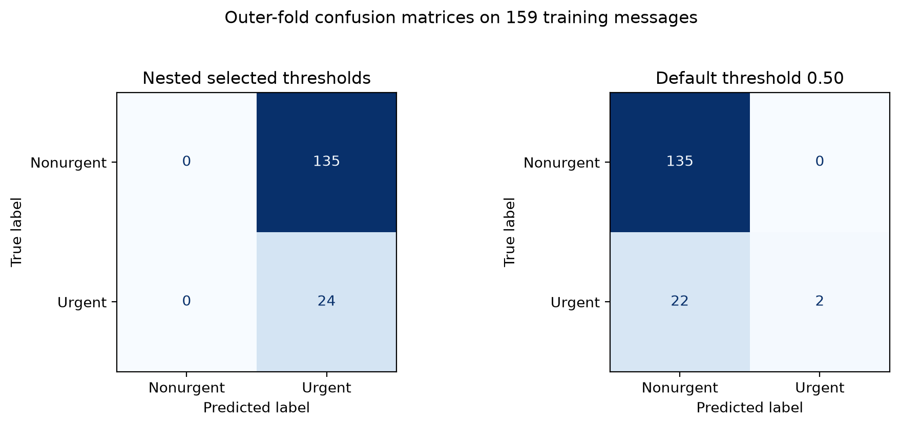
Threshold testing exposed the reliability problem
Threshold testing exposed the reliability problem
0.45 threshold
100% urgent recall 26.2% urgent F1 135 false positives
Every training message was labeled urgent.
0.50 threshold
8.3% urgent recall 15.4% urgent F1 22 false negatives
7
Notes:
Recording timing: 4:12-4:59
Threshold testing exposed the central reliability problem. At zero point four five, urgent recall reached one hundred percent, but every one of the one hundred fifty-nine training messages was labeled urgent. That created one hundred thirty-five false positives and removed the value of prioritization. At zero point five zero, there were no false positives, but urgent recall fell to eight point three percent. The model found only two of twenty-four urgent messages and missed twenty-two. Another warning is that one hundred fifty-seven probabilities fell between the two thresholds. A change of only zero point zero five therefore moved the system from almost no urgent predictions to all urgent predictions. Neither threshold provides a defensible operating point.
[Sources]
- notebooks/week6_testing_debugging.ipynb
- results/metrics/week6_threshold_analysis.csv
- results/metrics/week6_outer_predictions.csv
- results/figures/week6_confusion_matrices.png

Slide 8
Software validation prepared the interface for Week 8
Engineering scope
Functional repeatability was tested separately from predictive reliability.
13
60
5
Automated tests covering API behavior, evidence integrity, and safe failure.
Synthetic inferences: three cases repeated 20 times with identical scores.
Gate A checks for boundary, determinism, non-retention, thresholds, and explanations.
8
Notes:
Recording timing: 4:59-5:52
Week 7 software validation was evaluated separately from predictive reliability. All thirteen automated tests passed. They covered the visible research-use disclosure, valid and invalid inputs, safe behavior when the model is unavailable, notebook execution, metric traceability, privacy-sensitive columns, and preservation of the revise decision. A separate validator ran three synthetic cases twenty times each, for sixty total inferences, and produced identical scores within each case. Five Gate A checks passed: artifact boundary, deterministic scoring, non-retention in the result record, threshold visibility, and bounded explanations. This evidence establishes software and interface readiness for the planned Week 8 demonstration. It does not substitute for labeled predictive testing.
[Sources]
- docs/week7_automated_test_report.md
- results/metrics/week7_demo_validation.json
- tests/test_week7_demo.py
- tests/test_week7_readiness.py

Slide 9
DISPOSITION
Software passed its check; the model still needs revision
Engineering check passed
Model disposition: revise
Human review required
No shadow or production approval
Notes:
Recording timing: 5:52-6:32
The final disposition is revise. Gate A passed as an engineering-readiness check for the planned Week 8 demonstration. Gate B failed because neither tested threshold met the combined recall, precision, F one, review-burden, stability, calibration, and untouched-evaluation requirements. Human review remains required, and shadow testing and production deployment remain unapproved. This conclusion is not a failed project outcome. It is the reliability finding produced by the testing process. The work demonstrates a transparent pipeline, exposes the failure mode, and prevents a weak operating point from being overstated.
[Sources]
- docs/week7_readiness_evaluation.md
- results/metrics/week7_readiness_gate_evaluation.csv
- docs/week7_conditional_advancement_gates.md

Slide 10
Week 8 should demonstrate the workflow—not overstate the model
DEMONSTRATE
IMPROVE
REASSESS
Controlled workflow
Show scoring, explanations, thresholds, human review, privacy, and safe failure.
New evidence
Add reviewed labels, grouped sampling, calibration work, and an untouched test set.
Conditional review
A new versioned candidate must pass Gate B before any shadow-test recommendation.
10
Notes:
Recording timing: 6:32-7:15
My recommendation is to demonstrate the validated research workflow in Week 8 while keeping the model decision unchanged. The next predictive experiment should add reviewed examples, reserve a genuinely untouched test set, use related-message grouping where needed, assess calibration, and review false negatives and a reproducible sample of false positives. The same privacy, reproducibility, human-review, and approval controls should remain in place. Only a separately versioned candidate that passes the predictive gates should be considered for a bounded, supervised shadow-test recommendation. Even that step would require an explicit human approval record; it would not create automatic production authorization.
[Sources]
- docs/week7_conditional_advancement_gates.md
- docs/week7_demo_runbook.md
- docs/project_review_guide.md

Slide 11
PROJECT ACCESS
Repository
and contact
https://github.com/kbroussard34749/
explainable-ai-email-triage
kbroussard34749@ucumberlands.edu
Notes:
Recording timing: 7:15-7:36
The repository contains the code, executed notebooks, figures, metrics, experiment records, automated tests, validation evidence, and the Week 8 demonstration runbook. It is available at the GitHub address shown here. Questions about the project can be sent to my University of the Cumberlands email address. Thank you.
[Sources]
- https://github.com/kbroussard34749/explainable-ai-email-triage

